Slide 1
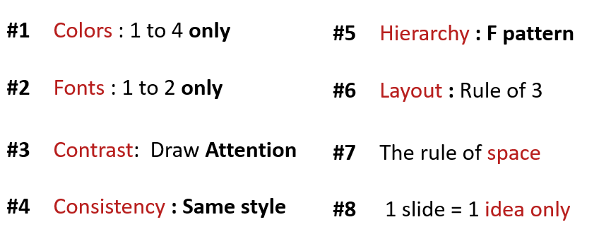
ACTIVITY 1
Analyze the 3 slides
Why they respect the design principle?

Slide 2
Computer / Database Diagram
Marketing is the study and management of exchange relationships. Marketing is the business process of creating relationships with and satisfying customers.
Analyze
Promotions only work as well as the marketing, to get your company’s.
+35
To get your company’s name out there.
Advertise
Promotions only work as well as the marketing, to get your company’s.
+10
To get your company’s name out there.
Identify
Promotions only work as well as the marketing, to get your company’s.

Slide 3
Comparison Chart
Marketing is the study and management of exchange relationships. Marketing is the business process of creating relationships with and satisfying customers.
Develop
Analyze
Promotions only work as well as the marketing. Promotions only work as well as the marketing.
vs.
Promotions only work as well as the marketing. Promotions only work as well as the marketing.
Promotions only work as well as the marketing.
Promotions only work as well as the marketing.
DEVELOP
DEVELOP
ANALYZE
ANALYZE
Promotions only work as well as the marketing.
Promotions only work as well as the marketing.
IDENTIFY
IDENTIFY

Slide 4
Title One
Promotions only work
as well as the marketing.
Title Two
Promotions only work
as well as the marketing.
Business
Infographics
Title Three
Promotions only work
as well as the marketing.
Marketing is the study and management
of exchange relationships.
Title Four
Promotions only work
as well as the marketing.
Title Five
Promotions only work
as well as the marketing.

Slide 5
Analyze the 3 slides
Slide1
Have the contrast color, pichure and fonts zixe.
Have the grup.
Have the pichure Emake.
Have the fonts zixe small.
Have the Clear information.
No one idea.
Slide 2
Have the contrast color , pichure and fonts zixe.
Have the grup.
Have the pichure Emake.
Have the fonts zixe small.
Unclear information.
No one idea.
Slide3
Have the contrast color pichure and fonts zixe.
Have the grup.
Have the pichure Emake.
Have the fonts zixe small.
Unclear information.

Slide 6
the 3 slides
Use​ of color according to the rules.
Use of fonts no good, because at slite have the fonts small.
Have the contrast in color and fonts zixe the color and pichure Emake.
Have the consistency have the color and fonts zixe.
Have the space.
Have rule fo 3.
No one idea only.

